Slide 1

Introduction to Jenkins
Module 5: Shared Libraries

Slide 2
Topics
Why Shared Libraries matter
Library structure and best practices
Global variables and helper utilities
Versioning and dependency strategy

Slide 3
Shared Libraries
As Jenkins usage increases in an organization
  Pipelines become long and repetitive
  Teams copy and paste logic
  The same fixes and updates have to be applied in multiple locations
  Coding and development standards drift over time
  Security practices become inconsistent
This leads to
  Maintenance pain from a fragmented pipeline code base
  Increased risk of errors in pipeline code
  Hard-to-govern pipelines since they don’t follow standards
  Increasing number of “snowflake” pipelines that are idiosyncratic

Slide 4
Shared Libraries
Shared libraries support
  Centralized reusable pipeline logic
  Best practices for coding and code quality
  Reduced duplication of code in pipelines
  Improved security and maintainability
Logic is encapsulated in library calls
  Explicit execution logic in a step
    sh 'mvn clean verify'
  Replaced by execution logic encapsulated in library calls
    RunMavenBuild()
  Pipelines describe intent; shared libraries implement behaviors

Slide 5
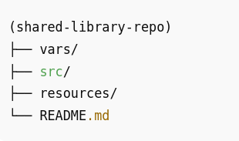
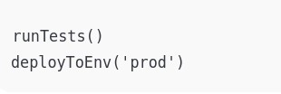
Library Structure
A Jenkins shared library is a Git repository
  It has a standard well-defined layout
  Not all of the directories are required
  This structure is considered a standard best practice
vars/
  Global pipeline steps
  Contains shared steps exposed directly to pipelines
  One file = one callable step
  File name becomes the step name
  Best practice
    Keep logic here simple
    Delegate complexity to src/

Slide 6
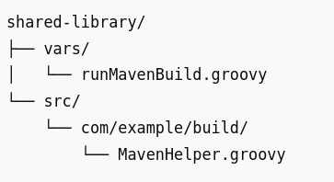
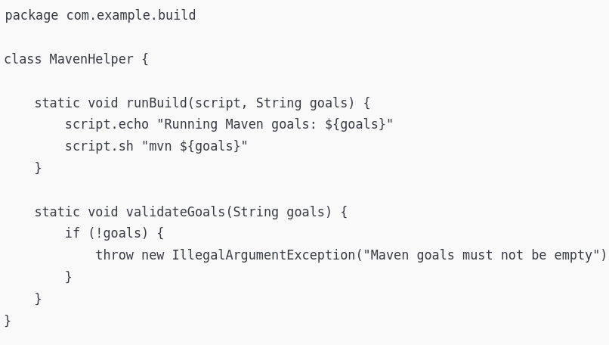
Library Structure
src/
  Helper utilities and classes
  Contains Groovy classes
  Used internally by shared steps
  Not exposed directly to pipeline code
Used for
  Validation logic
  Parsing
  Reusable utilities
  Complex workflows
Analogy
  vars/ is the API
  src/ is the implementation

Slide 7
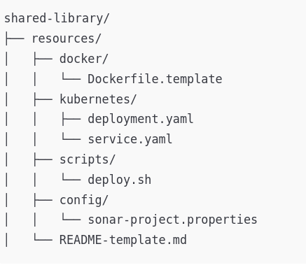
Library Structure
resources/
  Templates and other assets
  Stores non-code artifacts
    YAML, JSON, XML, shell scripts, templates
  Loaded at runtime
Common uses
  Kubernetes manifests
  Deployment templates
  Configuration files

Slide 8
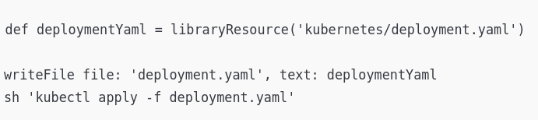
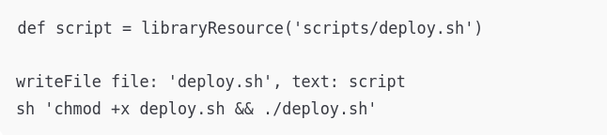
Library Structure
How resources are loaded
  The libraryResource step loads files from resources/
  In the example, the configuration files needed are created from the corresponding resource
  Avoids hardcoding files or strings
Best practices
  Avoid putting complex logic directly in pipelines
  Don’t expose too many global steps
  Don’t duplicate logic across libraries
  Don’t let different teams modify shared libraries directly

Slide 9
Versioning Strategies
Shared libraries should be
  Versioned
  Predictable
  Reproducible
Without versioning
  Library changes can break pipelines
  Debugging becomes difficult
  Rollbacks are painful

Slide 10
Versioning Strategy
Common approaches
  Git tags (v1.0.0)
  Branches (main, stable)
  Semantic versioning
Pipelines can
  Lock to a version
  Upgrade intentionally
  Test changes safely

Slide 11
Managing Library Dependencies
Best practices
  Minimize library dependencies
  Avoid circular dependencies
  Keep libraries focused on a single area of functionality
  Prefer one “core” shared library with additional specialized libraries
  Shared libraries should evolve slowly and carefully
Governance and control in enterprise setups
  Library changes require review for potential risks and impact on pipelines
  CI tests validate libraries to ensure they don’t regress
  Releases are documented
  Breaking changes are communicated to ensure dependencies can be modified
  Shared libraries become part of the enterprise Jenkins environment

Slide 12
Questions

